Slide 1
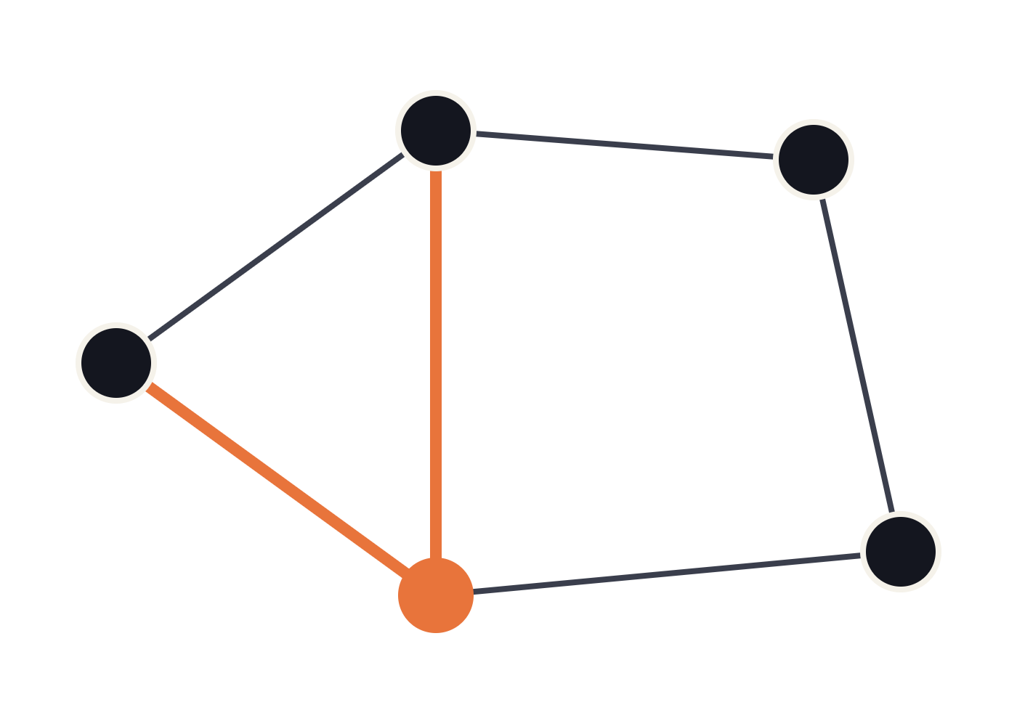
Dijkstra's Algorithm
GRAPH ALGORITHMS
Finding the shortest path through a weighted graph, one closest node at a time
Notes:
Welcome. Today we look at Dijkstra's algorithm, the classic method for finding shortest paths in a graph whose edges have non-negative weights.

Slide 2
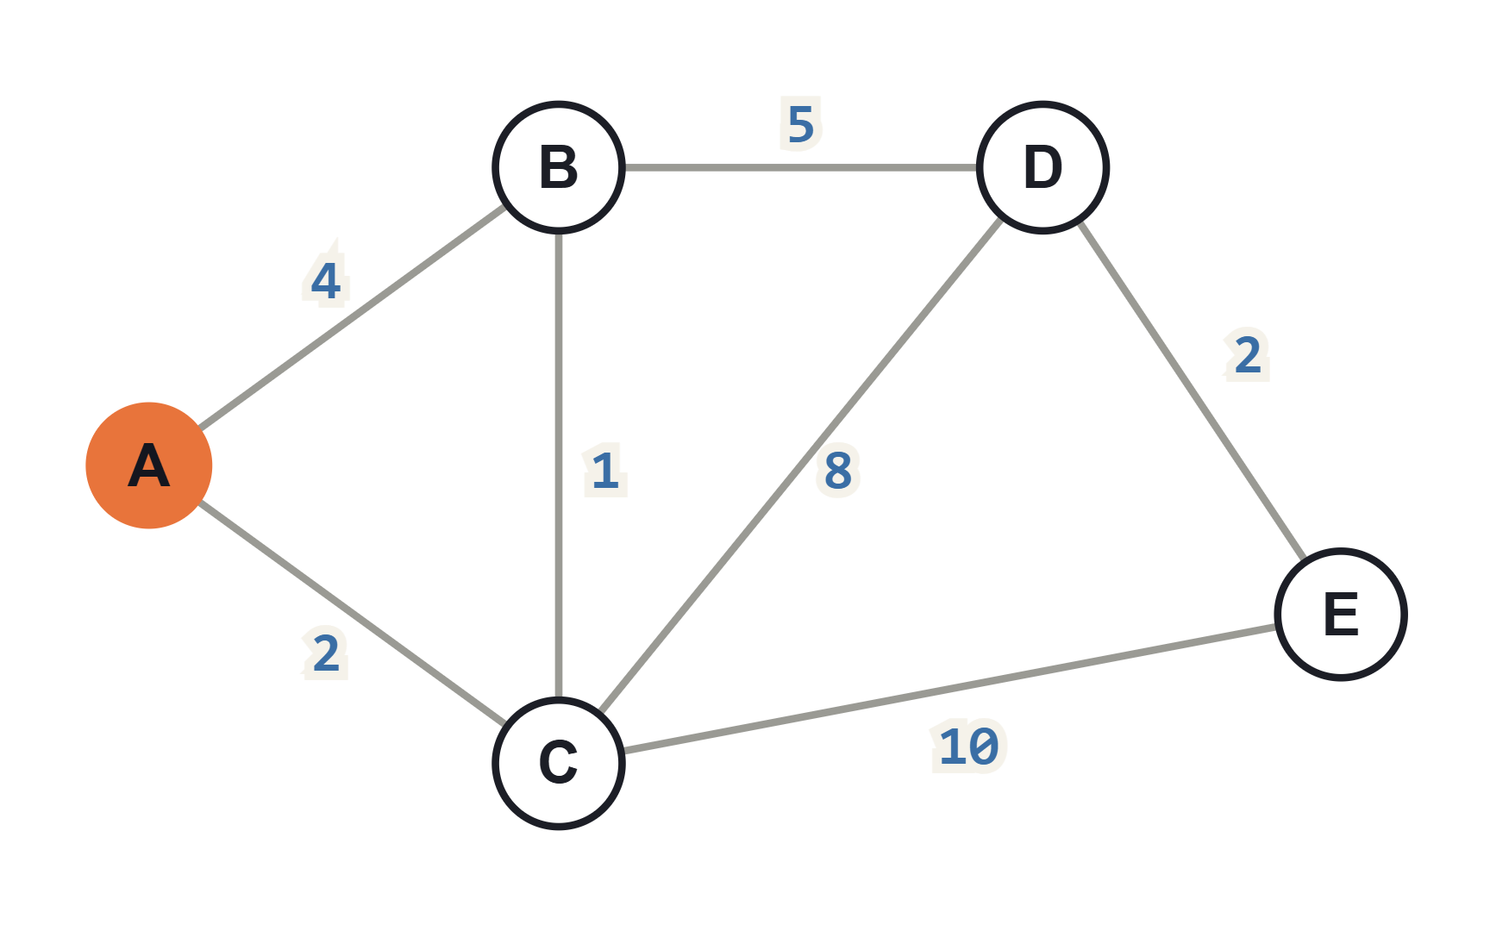
The shortest-path problem
Given a graph whose edges carry non-negative weights (distance, time, cost) and a source node, find the cheapest path from the source to every other node.
Here: from A, the direct edge to B costs 4, but going A → C → B costs only 3. The shortest path is not always the most direct one.
02
Notes:
Define the problem: single-source shortest paths. Point out that A to B direct costs 4 but A-C-B costs 3. This graph is reused in the worked example later.

Slide 3
The core idea: be greedy
Always finalize the unvisited node closest to the source. With no negative edges, no later detour can ever make it cheaper.
dist[ ]
visited
priority queue
Best distance found so far to each node. Starts at 0 for the source, ∞ for the rest.
Nodes whose distance is final. Once in, a node is never revisited.
Hands back the unvisited node with the smallest dist[ ] quickly.
03
Notes:
Dijkstra conceived the algorithm in 1956 and published it in 1959. The key insight is greedy: the closest unvisited node already has its final distance, because any other route would have to pass through a farther node first, and edges can't be negative.

Slide 4
The algorithm in four steps
1
Initialize
2
Pick the closest
dist[source] = 0, every other node = ∞. Put the source in the queue.
Remove the unvisited node u with the smallest dist[u]. Mark it visited.
3
Relax its edges
4
Repeat
For each neighbor v, if going through u is cheaper, update dist[v].
Go back to step 2 until every reachable node is visited.
04
Notes:
Walk through the loop. Steps 2 and 3 repeat once per node. Keeping a prev[] array alongside dist[] lets you rebuild the actual path, not just its length.

Slide 5
THE KEY OPERATION: RELAXATION
if dist[u] + w(u, v) < dist[v]:
dist[v] = dist[u] + w(u, v)
prev[v] = u
"Is the route through u cheaper than the best I know for v?" If yes, take it and remember u as v's predecessor.
05
Notes:
Relaxation is the only place distances change. Each edge is relaxed at most once, when its source node is settled. prev[] records the path tree.

Slide 6
Worked example: tracing from A
Step | Settle | A | B | C | D | E
Start | — | 0 | ∞ | ∞ | ∞ | ∞
1 | A | 0 | 4 | 2 | ∞ | ∞
2 | C | 0 | 3 | 2 | 10 | 12
3 | B | 0 | 3 | 2 | 8 | 12
4 | D | 0 | 3 | 2 | 8 | 10
5 | E | 0 | 3 | 2 | 8 | 10
Orange = a value that just improved through relaxation.
Step 2: settling C drops B from 4 to 3 (A→C→B).
Steps 3–4: D falls 10 → 8, then E falls 12 → 10, each by routing through the node just settled.
06
Notes:
Same graph as slide 2. Each row is one iteration: we settle the smallest unvisited distance, then relax its edges. Note how B's tentative 4 gets beaten by 3 once C is settled.

Slide 7
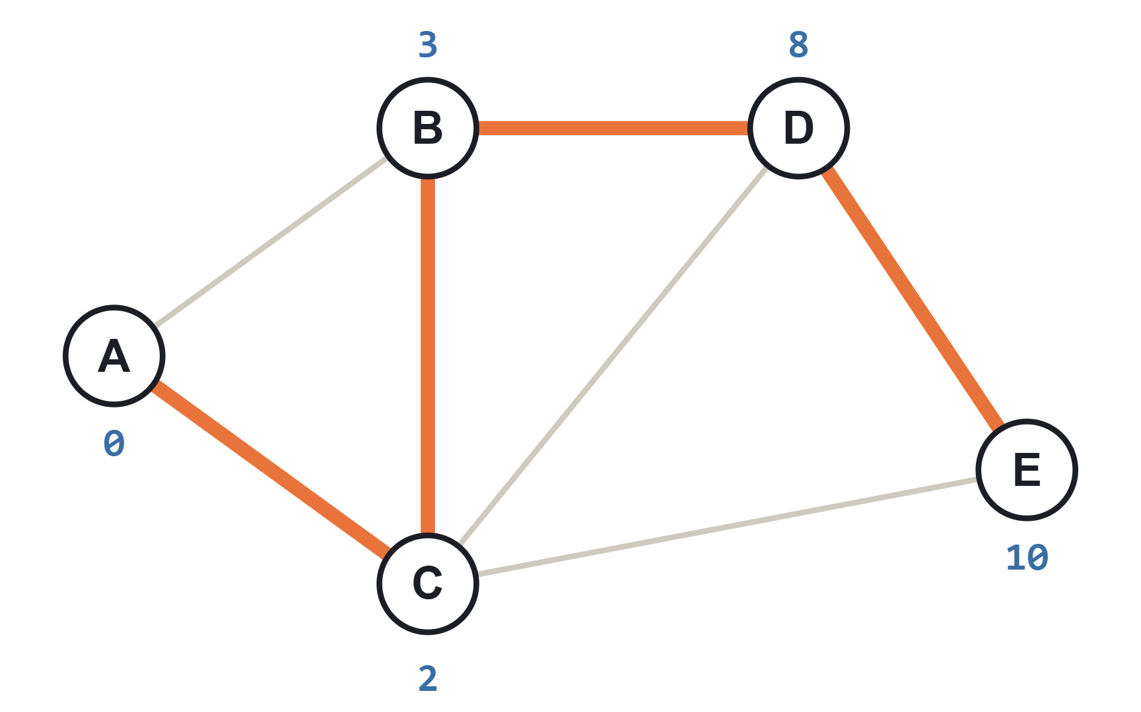
Result: a shortest-path tree
To | Path | Cost
B | A → C → B | 3
C | A → C | 2
D | A → C → B → D | 8
E | A → C → B → D → E | 10
07
Notes:
Following prev[] backwards from any node gives its path. The highlighted edges form a tree rooted at A. Note E is reached for 10 via D, not 12 via the direct C-E edge.

Slide 8
In code: Python with a min-heap
graph maps each node to a list of (neighbor, weight) pairs.
import heapq
def dijkstra(graph, source):
dist = {node: float('inf') for node in graph}
Instead of updating keys in the heap, we push a new entry and skip outdated ones when popped ("lazy deletion").
dist[source] = 0
pq = [(0, source)]
while pq:
d, u = heapq.heappop(pq)
if d > dist[u]:
Add a prev dict in the inner if to recover paths.
continue # stale entry
for v, w in graph[u]:
if d + w < dist[v]:
dist[v] = d + w
heapq.heappush(pq, (dist[v], v))
return dist
08
Notes:
This is the most common practical implementation. The "if d > dist[u]: continue" line replaces the visited set: an entry is stale if a cheaper one for u was already processed.

Slide 9
Running time depends on the queue
Priority queue | Time | Best for
Plain array (linear scan) | O(V²) | Dense graphs, E close to V²
Binary heap | O((V + E) log V) | Sparse graphs; the usual choice
Fibonacci heap | O(E + V log V) | Theoretical best; rarely faster in practice
V = number of nodes, E = number of edges. Extra space: O(V) for dist[ ] and prev[ ], plus the queue.
09
Notes:
Each node is extracted once and each edge relaxed once; the queue decides how expensive those operations are. For most real graphs, which are sparse, the binary heap wins.

Slide 10
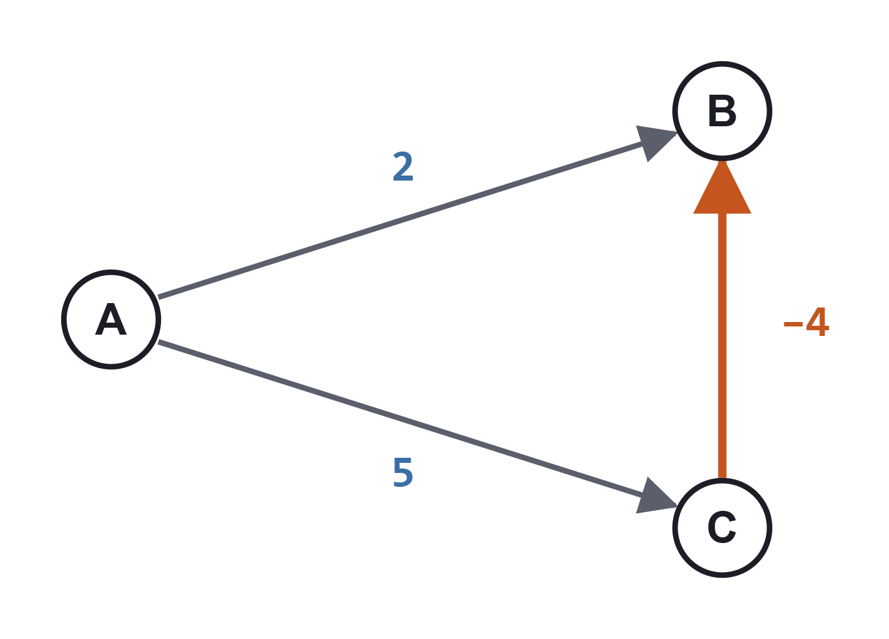
The limit: negative edge weights
Dijkstra settles B at 2 because it is the closest node.
But A → C → B costs 5 − 4 = 1. B was finalized too early, and the answer is wrong.
Use Bellman–Ford instead
Handles negative weights and detects negative cycles, in O(V·E) time.
10
Notes:
The greedy argument assumed that extending a path never makes it cheaper. A negative edge breaks that assumption, so a settled node can later turn out to have a cheaper route.

Slide 11

Where it shows up
[icon: map]
Maps and navigation
Network routing
Road networks with travel times as weights; often sped up with A* or precomputation.
Link-state protocols such as OSPF compute routes from each router with it.
[icon: gamepad]
Games and robotics
[icon: share]
Any "cheapest sequence"
Pathfinding on grids and terrain; A* is Dijkstra plus a distance-to-goal estimate.
Flight connections, currency or task scheduling: whenever steps have non-negative costs.
11
Notes:
Mention that A* is a direct generalization: it orders the queue by dist plus a heuristic estimate of the remaining distance, which focuses the search toward the goal.

Slide 12
Key takeaways
01
Greedy: always settle the closest unvisited node.
02
Relaxation updates distances; prev[ ] rebuilds the paths.
03
With a binary heap: O((V + E) log V).
04
Non-negative weights only; otherwise use Bellman–Ford.
Notes:
Recap the four points, then open the floor for questions.

